Slide 1

SECURE LINUX-BASED APACHE WEB SERVER DEPLOYMENT WITH SECURITY HARDENING AND MONITORING
Daffodil International University | Spring 2026
1

Slide 2

65_A, GROUP-02
Presented To
Presented By
Shafin Ahmed (232-15-184)
Sakib Ahmed (232-15-085)
Shisita Sarkar Setu (232-15-762)
Nayeem Siddique Bijoy (232-15-566)
Habibur Rahman (232-15-288)
Husne Mubarak
Lecturer
Department of CSE
Daffodil International University
Daffodil International University | 2026
2

Slide 3
TOPICS
  Introduction & Problem Context
  Objectives & System Architecture
  Objectives & System Architecture
  Implementation & Demo
  Results, Impact & Conclusion
Daffodil International University | 2026
3

Slide 4
INTRODUCTION & PROBLEM CONTEXT
-NAYEEM SIDDIQUE BIJOY (232-15-566)
4

Slide 5

INTRODUCTION & PROJECT OVERVIEW
  Project: Secure Linux-Based Apache Web Server
  Web server with security & monitoring
  Protects data from cyber threats
  Ensures reliable service
5
Photos retrieved from Google Gemini

Slide 6

BACKGROUND & PROBLEM
  Web servers handle client requests
  Core part of internet services
  Default servers lack security
  Risk: unauthorized access, cyber attacks
6
Photos retrieved from Google Gemini

Slide 7

MOTIVATION & GOAL
  Rising cyber threats
  Need secure systems
  Protect sensitive data
  Goal: Secure & reliable web server
7
Photos retrieved from Google Gemini

Slide 8
OBJECTIVES & SYSTEM ARCHITECTURE
-SHISITA SARKAR SETU (232-15-762)
8

Slide 9

PROJECT OBJECTIVES
  Deploy Apache Web Server on Linux
  Enable Multi-site Hosting (Virtual Host)
  Implement Secure Communication (HTTPS)
  Configure Firewall (UFW)
  Monitor Server Activity (Logs)
  Apply Basic Security Hardening
9
Photos retrieved from Google Gemini

Slide 10

SYSTEM ARCHITECTURE
User (Browser)
↓
Apache Web Server
↓
Linux OS (Ubuntu)
↓
Security Layer (HTTPS + Firewall)
↓
Monitoring Layer (Logs)
10
Photos retrieved from Google Gemini

Slide 11
Core Components
  Virtual Hosting → Multiple websites
  HTTPS → Secure encrypted communication
  Firewall (UFW) → Access control
  Monitoring → Log tracking & analysis
11
Photos retrieved from Google Gemini

Slide 12
METHODOLOGY & PROJRCT PLAN
-HABIBUR RAHMAN (232-15-288)
12

Slide 13
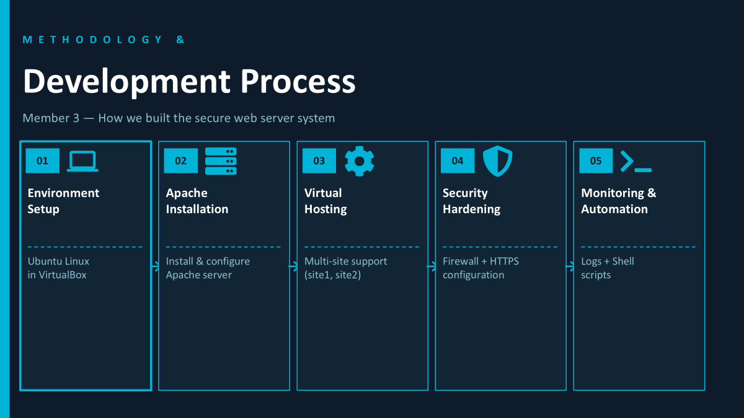
13

Slide 14
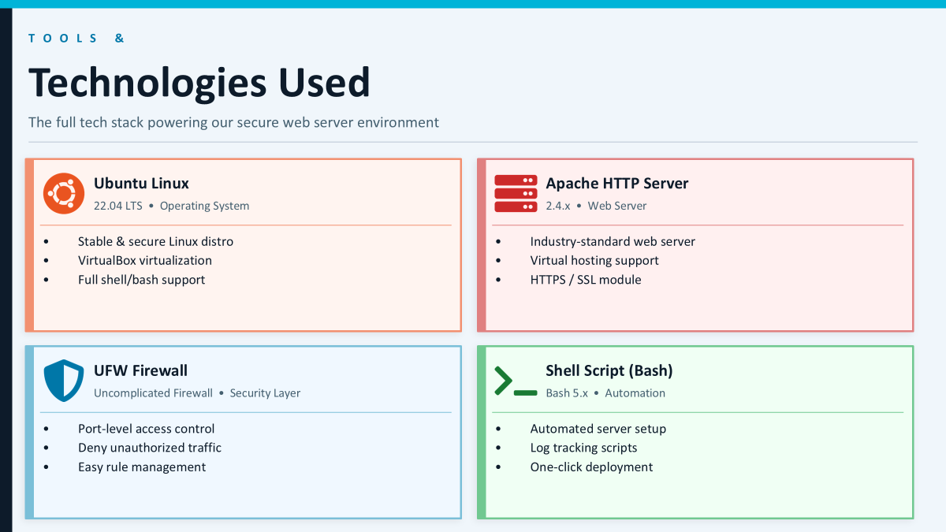
14

Slide 15
IMPLEMENTATION & DEMO
-SHAFIN AHMED (232-15-184)
15

Slide 16

Features Check & Verify
  Server Status
  Virtual Hosting
  HTTPS Configuraton
  Firewall Setup
  Access Monitoring
🎞️LIVE Demonstration
Presented By Shafin Ahmed_232-15-184
Photo credit Plant UML

Slide 17
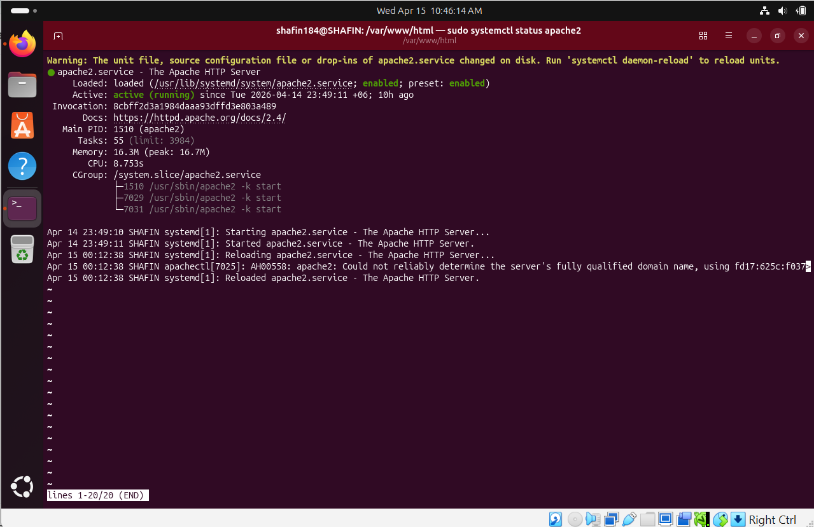
Server Status Verify
Presented By Shafin Ahmed_232-15-184

Slide 18
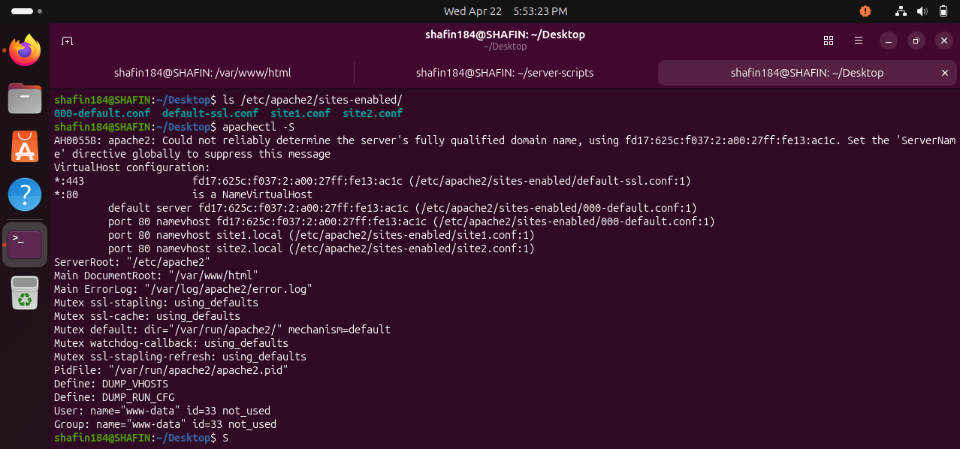
Checking Virtual Host Configuration
Presented By Shafin Ahmed_232-15-184

Slide 19
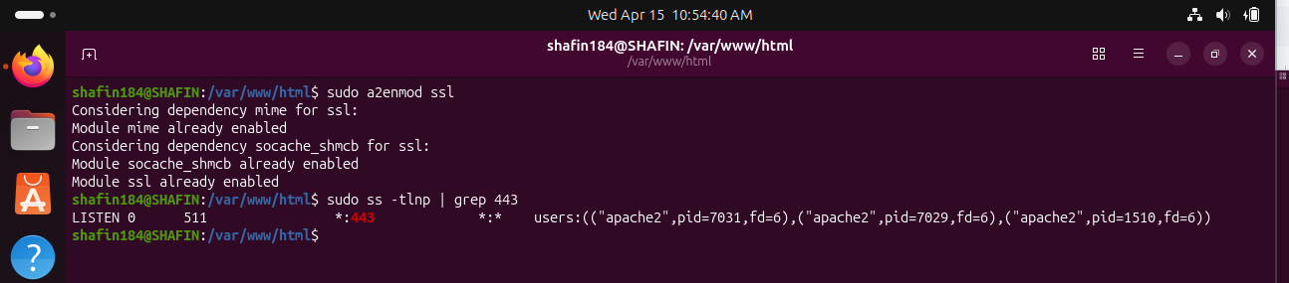
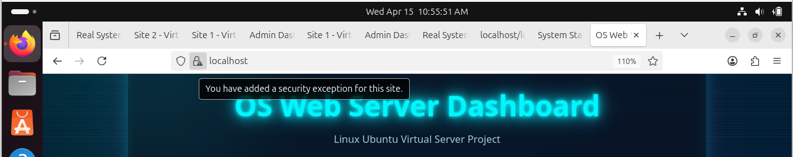
HTTPS Configuration Verify
Presented By Shafin Ahmed_232-15-184

Slide 20
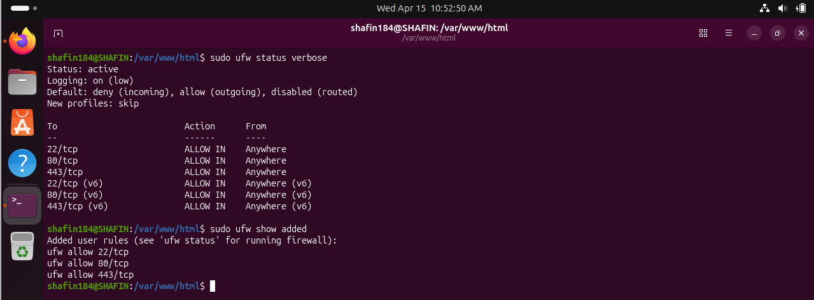
Firewall Check
Presented By Shafin Ahmed_232-15-184

Slide 21
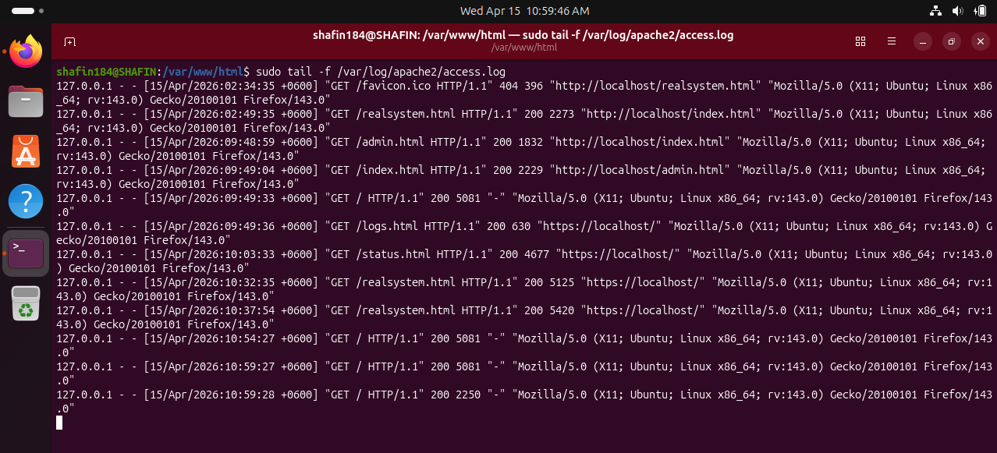
Verifying Access Monitoring
Presented By Shafin Ahmed_232-15-184

Slide 22
LIMITATIONS AND FUTURE WORK
-SAKIB AHMED (232-15-085)
22

Slide 23

Limitations
1.Virtualized Environment Limitation
  The project is implemented using VirtualBox. This is good for learning and testing, but it does not fully represent a real production-level cloud or enterprise environment.
2.No Scalability and High Availability Features
  The system does not include advanced features such as load balancing, clustering, or failover mechanisms. So, it may not handle large traffic or server failure properly.
3.Use of Self-Signed SSL Certificate
  The project uses a self-signed SSL certificate for HTTPS. Although it enables encryption, browsers still show security warnings because the certificate is not issued by a trusted Certificate Authority (CA).
4.Basic Monitoring System
  The monitoring system is simple and mainly depends on manual log checking using commands like tail -f. There is no centralized logging system, alert system, or graphical dashboard.
5.Limited Automation
  Some shell scripts are used for automation, but the system is not fully automated or scalable. Tools like Ansible, Puppet, or Docker are not used for better deployment and portability.
6.Basic Security Hardening
  Security hardening is applied only at a basic level, mainly through firewall rules and Apache configuration. Advanced tools like IDS, fail2ban, or Web Application Firewall (WAF) are not integrated.
7.Not Fully Ready for Real-World Deployment
  Although the system works well for academic purposes, it still needs more improvements to meet industry-grade production standards.
23

Slide 24
Limitations
Future Work
  Development of a fully automated deployment script (advanced Bash automation) to install and configure Apache, virtual hosts, firewall, and SSL with a single execution
● Improvement of the current shell scripts by adding error handling, logging, and rollback mechanisms for safer configuration changes
● Integration of automated server health monitoring system that continuously checks Apache status, port availability, and disk usage
● Implementation of auto-restart mechanism for Apache service in case of failure using systemd service configurations
● Enhancement of log monitoring by adding automated log analysis scripts to detect suspicious activities (e.g., repeated 404/401 requests, brute-force patterns)
● Introduction of basic AI-based anomaly detection using simple Python scripts to identify unusual traffic patterns from access logs
● Automation of backup system for website files and configuration directories (/var/www, /etc/apache2) using scheduled cron jobs
24

Slide 25
QUESTION?
25

Slide 26
THANK YOU
26

